Slide 1

Medical Insurance Charge Prediction
A Random Forest Regressor Model

Slide 2
Medical Insurance Charge Prediction A Random Forest Regressor Model
Name: Korukonda Yaswanth
Registration Number:
Course:
Institution:
Guide:
Date of Presentation:

Slide 3

Introduction
Brief Overview of the Project
The project titled "Medical Insurance Charge Prediction: A Random Forest Regressor Model" aims to develop a machine learning-based system that predicts medical insurance costs.
The model uses key inputs such as age, sex, BMI, number of children, smoking status, and region to estimate charges.
A Random Forest Regressor is selected due to its ability to handle both categorical and numerical data with high accuracy.
The system is deployed as a Flask-based web application to allow real-time predictions through a simple user interface.

Slide 4
Introduction
Importance of the Topic:
In today’s rapidly evolving healthcare landscape, the ability to accurately predict medical insurance charges is more critical than ever. Traditional methods of estimating insurance costs often involve manual calculations that are time-consuming and prone to human error. These methods fail to consider the complex interplay of various factors such as age, BMI, lifestyle habits, and regional differences. By leveraging machine learning, specifically the Random Forest Regressor, this project offers a data-driven solution that improves the accuracy, efficiency, and transparency of insurance cost estimation. Such predictive systems can empower individuals to make informed financial decisions and enable insurance providers to offer fair and customized policy pricing, ultimately contributing to a more sustainable and efficient healthcare ecosystem.

Slide 5

Objectives of the Project
To identify and analyze key factors affecting medical insurance charges (e.g., age, BMI, smoking status).
To build a predictive model using the Random Forest Regressor algorithm.
To perform data preprocessing including handling missing values, encoding categorical variables, and normalizing numeric data.
To evaluate the model's performance using MAE, MSE, and R² Score for accuracy and reliability.
To compare Random Forest with baseline models like Linear Regression and Decision Tree.
To deploy the trained model in a Flask-based web application for real-time prediction.
To enable users to enter their health and demographic details and receive cost predictions instantly.

Slide 6

Problem Statement
Traditional insurance cost estimation is manual, time-consuming, and lacks transparency.
Users often need to contact multiple agencies just to get an estimate.
This leads to privacy concerns and unwanted spam calls and marketing pressure.
There is no simple, free, and anonymous tool for users to estimate insurance charges.
The project aims to build a free and user-friendly prediction tool using machine learning.

Slide 7

Scope of the Project
Included (What is covered):
Uses a public dataset (from Kaggle) with 1300+ records.
Predicts insurance charges based on 6 inputs: age, sex, BMI, children, smoker, and region.
Applies Random Forest Regressor to ensure high accuracy.
Deployed via a Flask-based web app for real-time prediction.

Slide 8

Scope of the Project
Excluded (Limitations):
Does not consider detailed medical history or chronic diseases.
Income level, education, and employment status are not included.
Predictions are based on historical data and may not reflect current market changes.
Limited to six input features due to dataset constraints.

Slide 9

Scope of the Project
Future Possibilities:
Add features like income, medical records, family history, or policy type.
Improve accuracy with ensemble learning or deep learning techniques.
Expand the app into a mobile platform or host it on the cloud for scalability.
Integrate with real insurance APIs for comparison or policy suggestions.

Slide 10

Methodology / System Architecture
Development Approach:
Waterfall Model followed for project execution:
Requirement Understanding
Data Collection
Preprocessing & Feature Engineering
Model Training & Evaluation
Web Application Development
Testing & Deployment
Tools & Technologies Used:
Python – Programming language
Pandas, NumPy – Data analysis & manipulation
Scikit-learn – Machine learning library
Matplotlib – Visualization
Flask – Web application framework
Jupyter Notebook / VS Code – Development environment

Slide 11

Tools and Technologies
Programming Language:
Python – Used for data analysis, model building, and backend logic.
Database:
No external database used – Dataset is loaded directly from a CSV file.
Platform:
Web-based Application – Built using Flask, accessible via browser (http://127.0.0.1:5000)
User-friendly HTML + CSS for form and output display
Supporting Libraries & Tools:
Scikit-learn – Machine learning model (Random Forest)
Pandas, NumPy – Data handling
Matplotlib – Data visualization
VS Code – Development environment

Slide 12
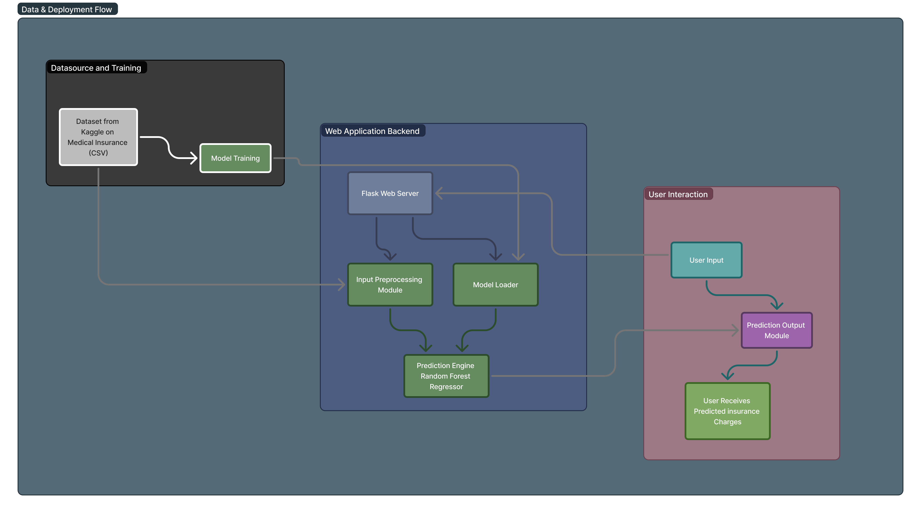

System Design

Slide 13
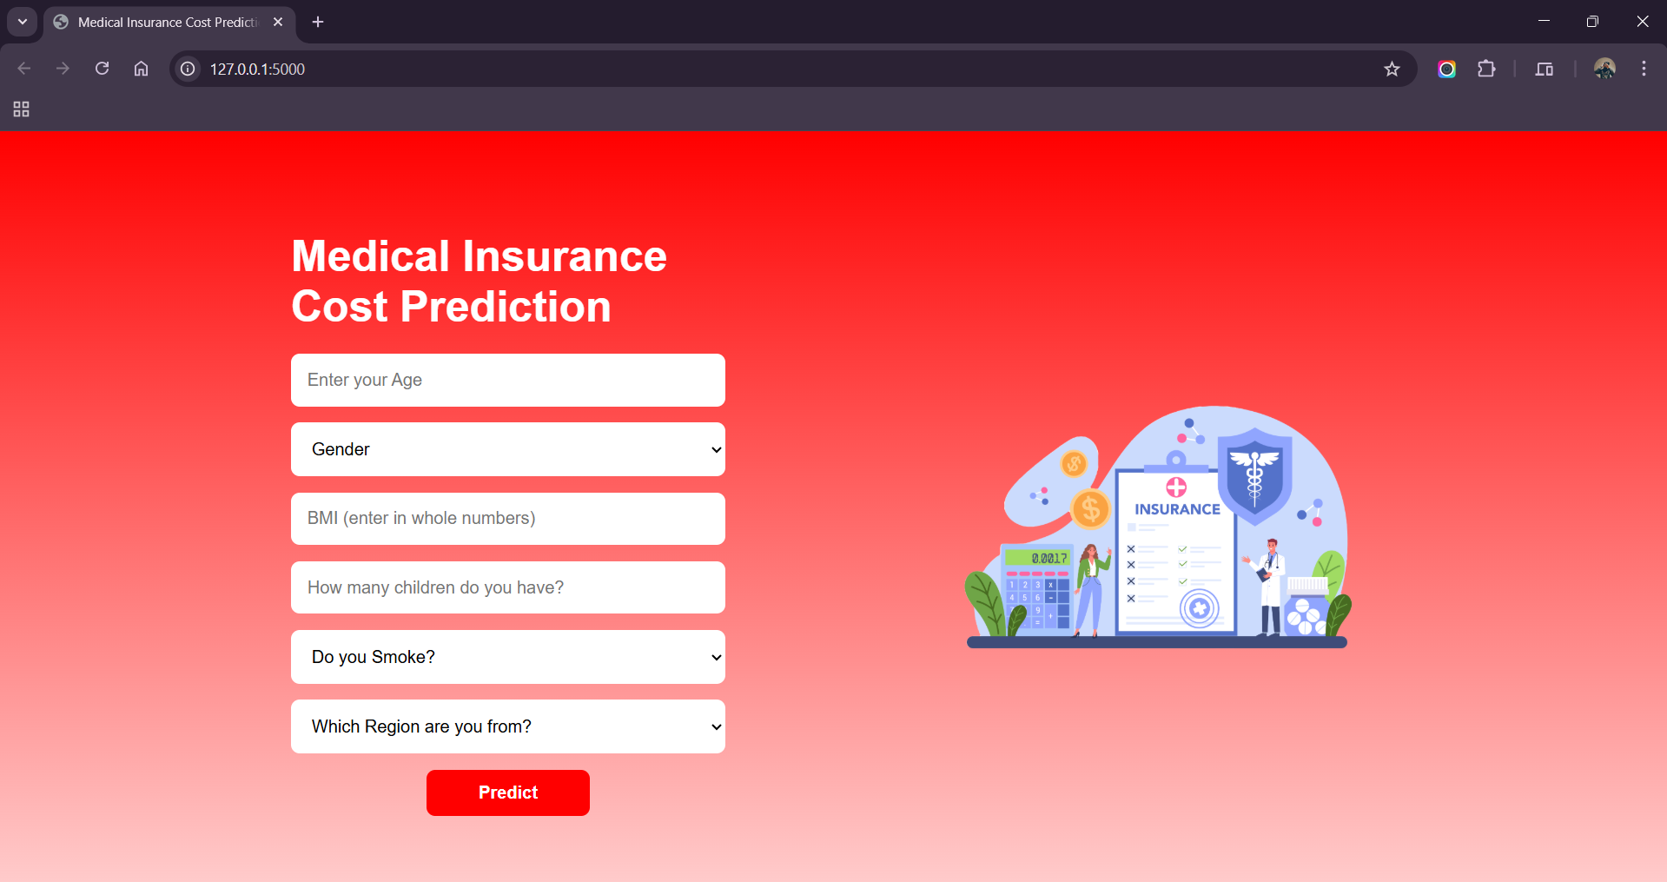
Homescreen

Slide 14
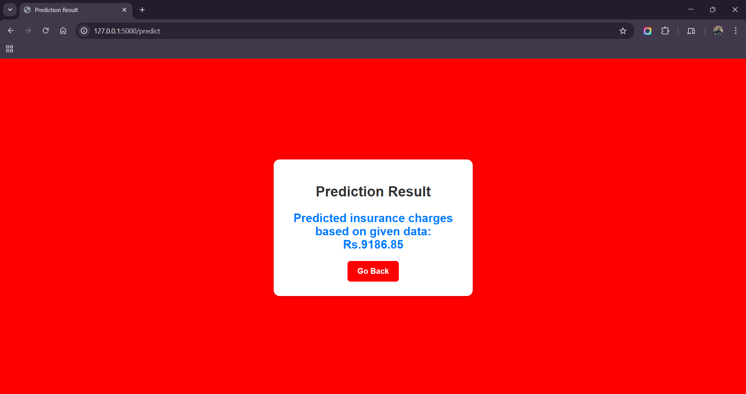
Output page

Slide 15

Analysis / Implementation
Project Execution:
Dataset collected from Kaggle (1300+ rows)
Performed data cleaning, encoding, normalization
Applied Random Forest Regressor for modeling
Model deployed using Flask on localhost
Modules Developed:
Data Preprocessing Module: Cleans, encodes, and scales input features
Model Training Script: Trains and evaluates Random Forest model
Web App (Flask): Handles user input, prediction, and display
HTML Interface: Frontend form and output page
Key Processes & Outputs:
Users enter 6 fields → Model returns predicted insurance cost
Achieved R² score of 0.86, outperforming Linear Regression and Decision Tree
Flask app provides real-time predictions in the browser

Slide 16

Findings and Results
Observations Based on Implementation:
The model achieved a strong R² score of 0.86 on the test data.
Random Forest outperformed Linear Regression and Decision Tree models.
Flask-based web application successfully deployed and runs on localhost.
Data Insights and Outcomes:
Smoking status is the most influential factor in predicting charges.
BMI and age also significantly affect insurance cost.
Minimal impact observed from region and gender.
Prediction results are accurate and consistent across varied test inputs.

Slide 17

Conclusion
Successfully built a machine learning model using Random Forest Regressor.
Achieved high prediction accuracy with R² score of 0.86.
Identified smoking, BMI, and age as the most impactful features.
Developed a working Flask web application for real-time insurance cost prediction.
Demonstrated the effectiveness of data-driven approaches in solving real-world problems.
The system is user-friendly and requires no personal data to generate predictions.

Slide 18

Future Scope
Include more features like medical history, income level, and education for deeper insights.
Use larger and more diverse datasets to improve generalization.
Upgrade model using advanced algorithms like XGBoost or Deep Learning for higher accuracy.
Deploy the web app on cloud platforms (e.g., AWS, Heroku) for public access.
Extend to mobile platforms (Android/iOS) for better accessibility.
Add API integration to connect with real insurance data and plans.
Implement user authentication and data storage for registered users.

Slide 19

References
Kaggle. (2024). Medical Insurance Cost Prediction Dataset. Retrieved from https://www.kaggle.com
Scikit-learn Developers. (2024). Scikit-learn Documentation. Retrieved from https://scikit-learn.org
Flask Documentation. (2024). Flask Web Framework. Retrieved from https://flask.palletsprojects.com
James, G., Witten, D., Hastie, T., & Tibshirani, R. (2013). An Introduction to Statistical Learning. Springer.
StorySet by Freepik. (2024). Illustrations used in slides. Retrieved from https://storyset.com

Slide 20

Thank You !
For your time and attention..
From concept to code – a presentation by Yaswanth Korukonda

Slide 21

Questions?
I’ll be Happy to answer..

